Slide 1
Merchant Accounting: Org. Resurrection
Sep 2022
@shivigarg
@sakshimor

Slide 2
Resurrection of inactive merchants; Segments 2&3
GPay Merchant Health Spectrum
x%
Probability of becoming MTM in the next 28D
Total Active Merchants: 13.3
Ever Transacted: 11.5M
Inactive previous 28D: 6.4M
MTM previous 28D: 5.1M f h
9.5%
79.4%
1.8M
Never txd
5.4M
Inactive for >56D
1M fh
<=56D inactive
2.4M g
1-6 txn
2.7M g
>6 txn
9%
30%
61%
96%
1. Never
2. Inactive
3. Churning
4. LowInt
5. HighInt
17%
37%
8%
18%
21%
Activation
Resurrection
Retention

Slide 3
Contents
Where
are we on Organic resurrection?
do merchants resurrect organically?
are resurrection drivers?
Why
What

Slide 4
Resurrection: Where are we?

Slide 5
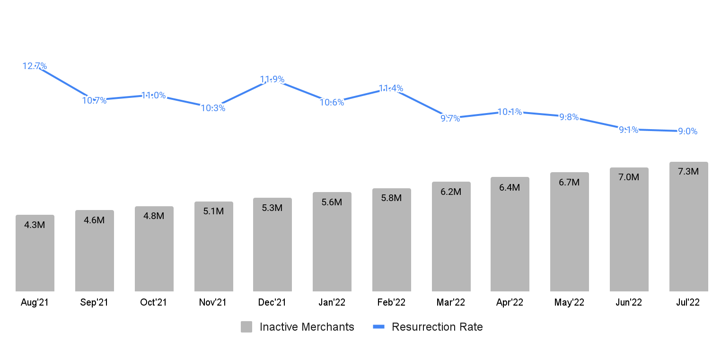
Where: Summary
GPay SMB resurrection @9.0% July’22, down 66bps vs. Q2’22
Update basis active flag
Resurrection increases during festivals, offer periods
28D % Resurrection Rate and Inactive Merchants MoM
Lockdown unlock + offers
Festive Sales
New Year + Christmas
-66bps drop in Resurrection Rate Jul’22 vs Q2’22; ~48k fewer resurrections (MTMs)
Inactive merchants grew by 69%, 7.3M in July’22 vs. Aug’21
Covid wave 3 unlock
Offers
Goal of this analysis: Understand drivers to improve “Resurrection”

Slide 6
Where: Summary
GPay SMB resurrection @9.0% July’22, down 66bps vs. Q2’22
On Inactive merchants < 1 Yr
Resurrection increases during festivals, offer periods
28D % Resurrection Rate and Inactive Merchants MoM
Lockdown unlock + offers
Festive Sales
New Year + Christmas
-66bps drop in Resurrection Rate Jul’22 vs Q2’22; ~48k fewer resurrections (MTMs)
Inactive merchants grew by 69%, 7.3M in July’22 vs. Aug’21
Covid wave 3 unlock
Offers
Goal of this analysis: Understand drivers to improve “Resurrection”

Slide 7
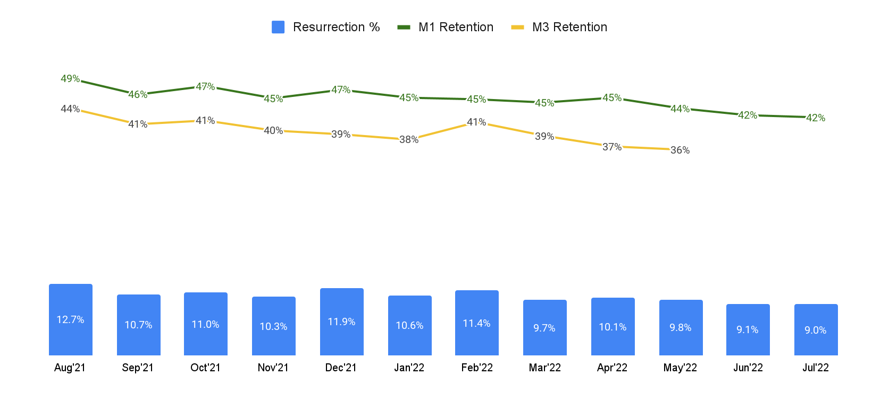
Where: Summary
Merchants retain at ~40% after 3 months from resurrection
…
%Resurrection and M1, M3 Retention Rate MoM

Slide 8
Why do merchants resurrect?

Slide 9
Approach: Understanding organic resurrection
HYPOTHESIS
1. SWINGERS: Merchants which resurrect at least 4 times in 1 yr
2. Consumer Pull: Gpay payers are asking for GPay QR
3. Merchants use GPay QR during competition outage
4. Merchant app notified of rewards, balance after reliability etc.
5. GPay as multiple QR to complete cashback quota, hedge against reliability
6. Resurrecting after facing a reliability issue
7. Rewards or Outbound Calls
8. Districts with use-case of lesser payments
9. Resurrected merchants received on consumer app while inactive
CATEGORY | FEATURE SET
Activity | Length of inactivity Retention before churning
Size/Profile | 28D Txn before churning Ticket size before churning # payers before churning Vintage
Competition | %Gpay txns Comp QR presence (Multiple QR)
Reliability | GPay Txn failure GPay Txn attempt (but failed) during inactivity Stuck txns
Behaviour | Merchant App Activity Bad Actor GMB Listing

Slide 10
WHY Summary
WHY do merchants Resurrect?
Refine Why + contrib
Hypothesis | WHY? | %Contrib,#MTMs NOT MECE | Recommendation
SWINGERs | Churned and resurrected at least 4 times in last 1 Yr; Low Intensity (93%), Bad actors (1.3x), Multiple QR (1.4x) merchants with switching behavior | 12% (75k) | Weed out merchants with “Swinging” behavior from offers/comms; Little value due to poor Retention
Consumer Pull | 62% of merchants resurrected by a GPay Consumer vs. avg 45%; Noted in strong Geos on merchants with low consumer pull bfr churning | 17% (147k) | Run SMB auto-vouchers in weaker states such as RJ, Bihar and AP
Competition Outage | 5 days of Competition outage contributed to 32% of resurrections vs. 16% (Avg. for 5 days) | 16% (107k) | Double down on Notifs/Comms during Comp outage; Provide Long-Term Retention “Welcome Offer” for improved Retention
App Active | Recently inactive merchants open app to view customer history & txn balance, bad actors open to view rewards & reliability hit merchants view to check their txns, 6M+ inactive merchants view QR Scan | 16% (108k) | Relevant notifs to merchant set, Ob calls or QR kit refresh to 6M+ merchants using QR scan on app
Using Multiple QRs | Merchants keeping multiple QR (to hedge for reliability or just having digital presence) resurrect high | 6% (46k) | Revisit high intensity single QR merchants to resurrect them back
Txn attempts during inactive state | Failed txn attempts on merchants during inactivity period likely due to worn-out QR kits | 3.7% (25k) | Enable QR Kit refresh
Reward, Ob Calls | Rewards: Positive signs of rewards overall; Little data to analyse in detail Ob calls: Data unavailable to analyse | ..
Districts with use-case of lesser payments | User Density data unavailable to analyse | ..
Resurrected merchants received on consumer app while inactive | Checked, no material insights | ..
Inactive as on Mar’22 and Apr’22 resurrected + Inactive as on Apr’22 and May’22 resurrected
Excludes revisited merchants from base

Slide 11
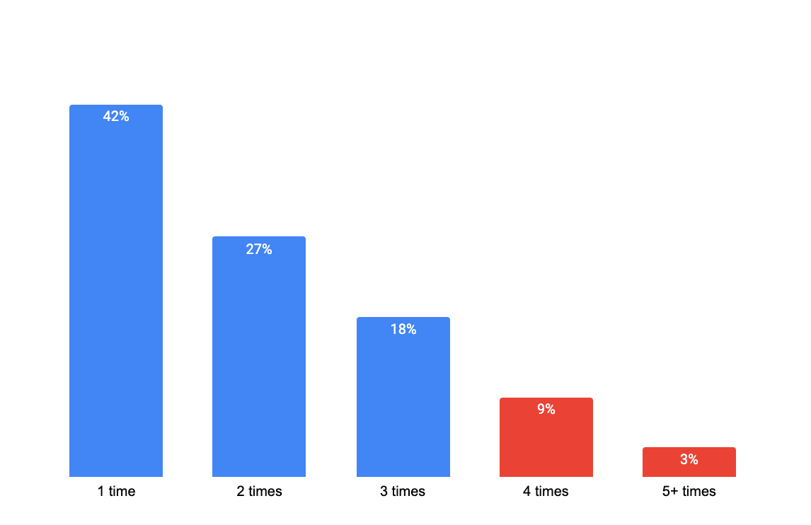
Behavior: SWINGERs
SWINGERS: ~12% of merchants churn & resurrect at least 4 times in 1 Yr
~20k merchants resurrected at least 5 times in 1 yr
% resurrected merchants by
number of times churned & resurrected in 1 Yr
93% of Swingers are Low-intensity merchants (<6 txns in 28d Days); SWINGERS receive ~1.2 txn (avg.) 28D before last churn
15% of SWINGERs are bad actors (1.3x of non-swingers); 14% have Comp QRs (1.4x of avg.)
17pp of resurrected merchants in WB are Swingers (vs. avg of 15pp); Maharashtra has least % of swingers @13pp
Marketing Services (19pp) & Novelty (18pp) has high % of Swingers; F&R (11pp) and Groceries least (13pp)
75k merchants
Weed out merchants with “Swinging” behaviour from offers/comms; Little value of SWINGERs considering poor retention
Inactive as on Jul’22 and Aug’22 resurrected
Excludes revisited merchants from base

Slide 12
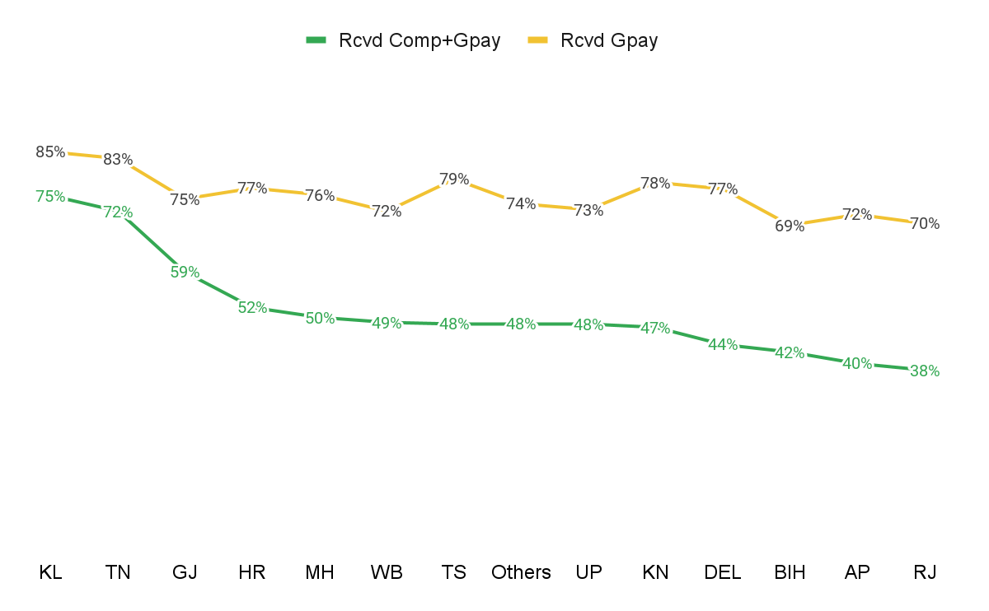
Comp: Consumer Pull
Consumer Pull: 62% merchants resurrected by GPay User
On avg. 45% of SMB txns are via GPay Users
Consumer preference before/after churning
Gpay preferred merch exhibit consumer pull in all Geos; Comp+GPay merchants exhibit pull basis Geo’s health in GPay
~680k resurrected merchants
Prior to Churning
Gpay preferred merchants (bfr churning) continue to exhibit consumer pull irrespective of Geo
Rcvd by only GPay (28D txn)
(49%, 330k)
Rcvd by Comp+GPay (28D txn)
(51%, 350k)
% Merch
H (0.5%) | M (5%) | L (94.5%)
H (10%) | M (25%) | L (65%)
~95% low intensity merchants sustained early churn likely due to GPay payer (Consumer preference)
% merchants Resurrected by Gpay Payer
Strong States
Mixed Bag
Weak States
78% | 80% | 75%
58% | 52% | 46%
Sustained preference
Run GPay SMB auto-vouchers in weaker states such as Rajasthan, Bihar and AP
Inactive as on Jul’22 and Aug’22 resurrected
Excludes revisited merchants from base

Slide 13
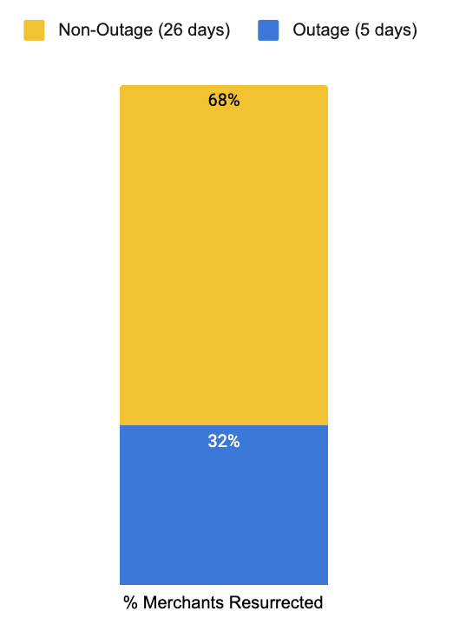
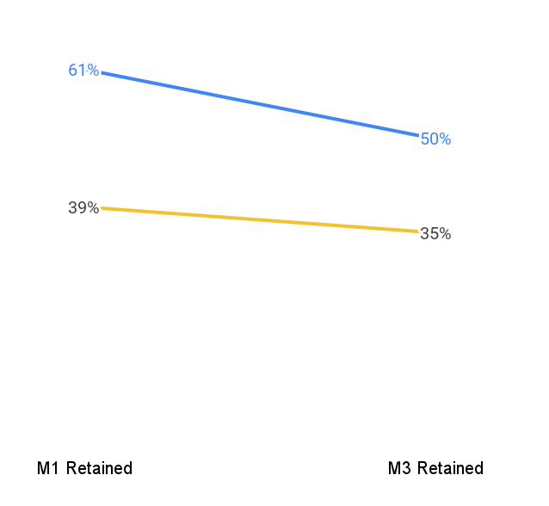
Comp Outage: 5 days of Comp Outage contribute to 32% resurrections
32% resurrections vs. 16% (avg. for 5 days); incremental 16% resurrections due to comp outage
%Resurrected during Comp Outage
Retention by merchants resurrected during outage vs. non-outage days
Retention for outage-resurrected merchants is 22pp higher
11pp decay for merchants resurrected during outage period
Vs. 16% (avg. %resurrected for 5 days in 31 days month)
Double down on Notifs/Comms during Comp outage to resurrect more merchants; Provide Long-Term Retention “Welcome Offer” to these merchants to make them stay longer
Inactive as on Feb’22 and Mar’22 resurrected , considering we only had 3rd party outage data till Month of March Excludes revisited merchants from base

Slide 14
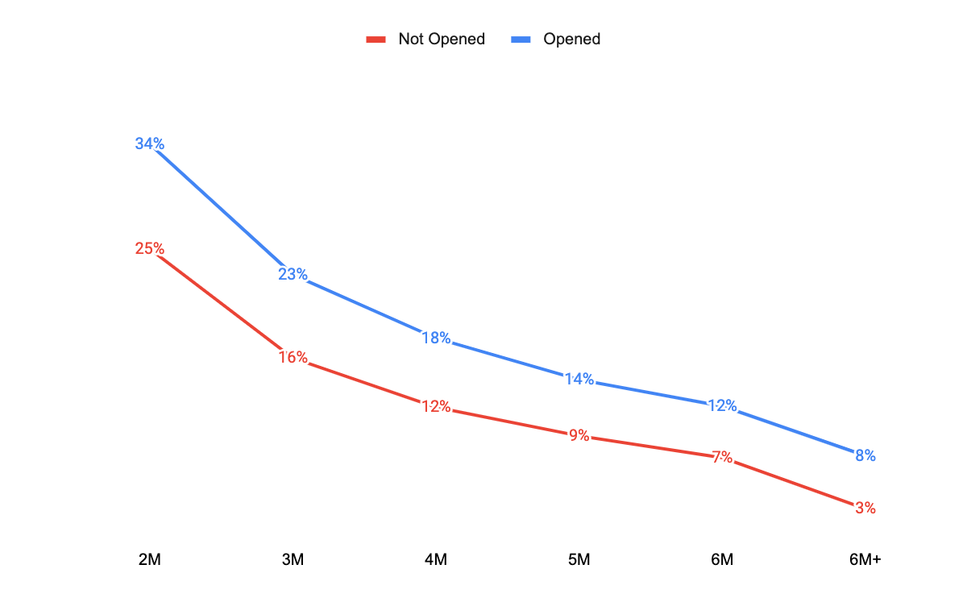
Bheavior: Merchant App
Opening the merchant app increases resurrection chances by xx
~25-27% of resurrected merchants open the merchant app at least once 28D prior to resurrection
28D Resurrection % and M1, M3 Retention by App Activity
WHICH merchants open the app?
Recently inactive merchants (56%, 1.4x avg)
Bad Actors (15%, 1.2x avg.)
Reliability issues (10%, 1.3x avg.)
WHICH features do app-active merchants engage with the most?
Customer History & Balance (40% who open)
Recently inactive merchants: 42% who open app, visit history & balance vs. avg 35%
Rewards & Offers (21%, during offer months)
Bad Actors: 31% who open app, visit rewards & offer page; vs. 20% good actors visit this screen
QR Scan (21%)
6M+ inactive merchants : potentially lost/damaged QR
Bad Actors: Potentially not actively using physical QR
% Resurr Merchants
56% | 18% | 9% | 5% | 3% | 9%
Recently churn merchants can be brought back via relevant notifs/comms; 6M+ inactive merchants browsing QR page may need QR kit refresh
Inactive as on Mar’22 and Apr’22 resurrected + Inactive as on Apr’22 and May’22 resurrected
Excludes revisited merchants from base

Slide 15
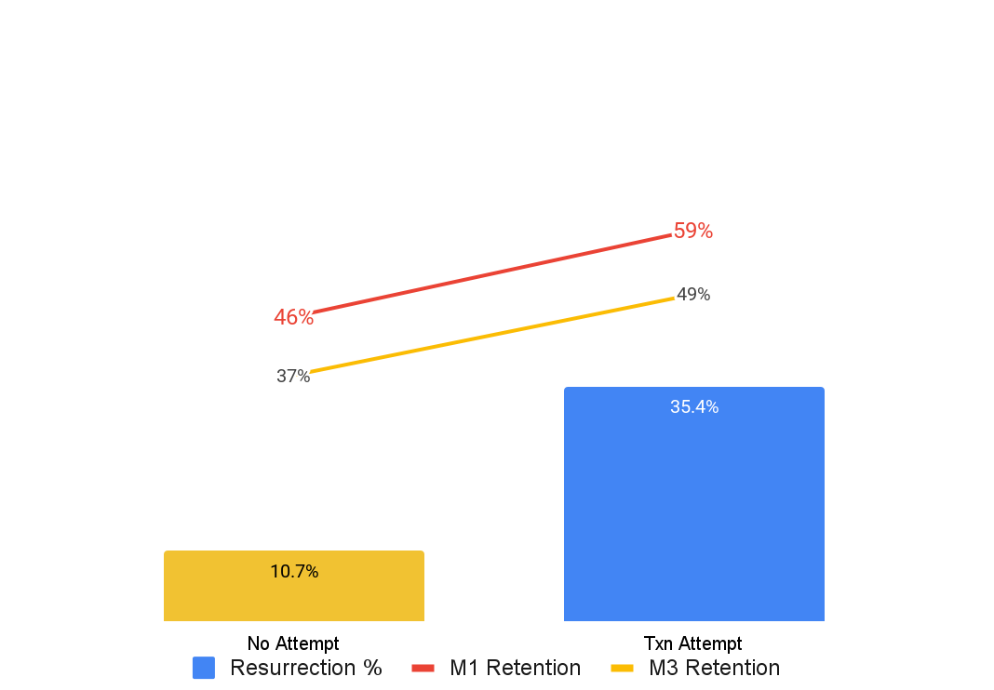
Reliability: Attempts
Merchants who attempted txn during inactivity resurrect 3.5x higher
Retention rate of this resurrected cohort is also 10pp higher than avg.
28D Resurrection % and M1, M3 Retention by txn attempts during inactivity
Only 2% merchants make a txn attempt 1 month prior to resurrection; Ensure successful payment for these merchants
States with txn attempts: %Merchants making attempts are highest in Maharashtra (17%) & UP (14%)
Categories with txn attempts: %Merchants making attempts are highest in Food & Rest (14%) & Groceries (19%)
Lost 46k MTMs in a month because of txn failure of inactivity merchants;
Low hanging fruits: QR Kit refresh for these merchants may improve resurrection rate of this cohort
Inactive as on Mar’22 and Apr’22 resurrected + Inactive as on Apr’22 and May’22 resurrected
Excludes revisited merchants from base

Slide 16
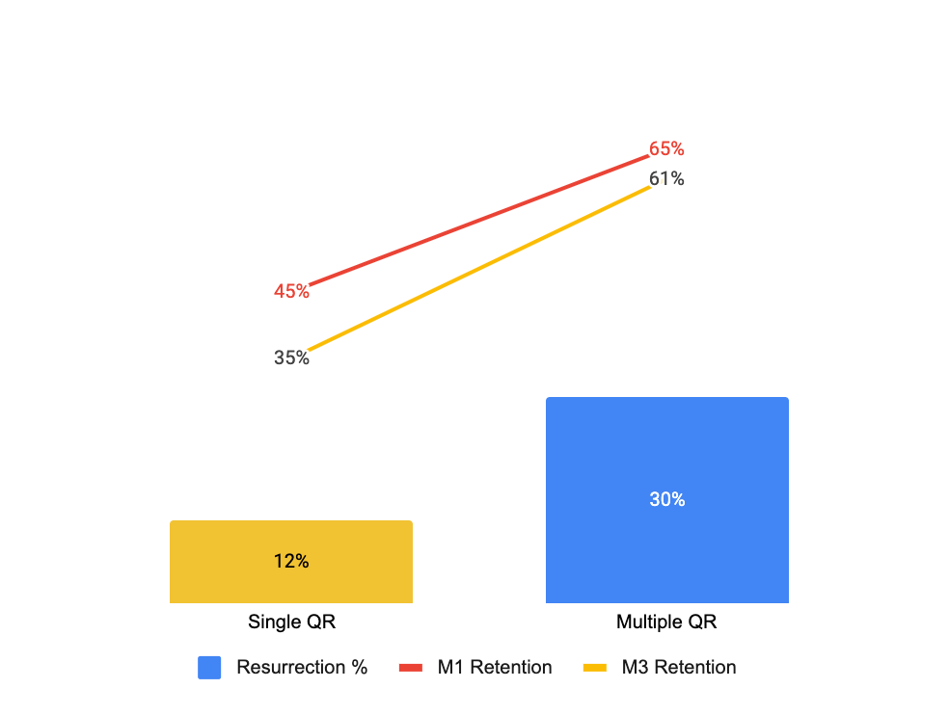
Comp: Comp QRs
Merchants using multiple QRs resurrect 3x higher vs. single QR
~10% of active GPay merchants are identified* to have a comp QR as well
28D Resurrection % and M1, M3 Retention by Comp QR Presence
WHY do Multiple QR merchants resurrect higher?
Not driven by bad-actor behaviour: Single QRs have 1.3x bad actors vs. Multiple QR merchants
Sizeable merchants keep multiple QRs: 1.3 times High+Mid size merchants; Retention decay on multiple QR is lowest for Low > Medium > High
Multiple QRs used to hedge against reliability issues: 6% of Multiple QR merchants have experienced failure in past (2.4x of Single QR)
After facing reliability issues, Multiple QR merchants are 1.5 times as likely to resurrect vs. Single QR merchants
Revisit high intensity single QR merchants to resurrect them back
Inactive as on Mar’22 and Apr’22 resurrected + Inactive as on Apr’22 and May’22 resurrected
Excludes revisited merchants from base
* Multiple QR is an internal estimation based on similar FOP, bank account etc, and is considered when similarity is >=90%

Slide 17
What drives resurrection?

Slide 18
What drives Resurrection? Features tested:
Highlighted important features
Activity | Size/Profile | Competition | Reliability | Behavior/ Engagement
Length of inactivity Retention bfr churning Support call | Txn Itensity Ticket Size #Payers Vintage | %Gpay txns Comp QR presence %Gpay payers | GPay Txn failure GPay Txn attempt (but failed) during inactivity Stuck txns | Merchant App Activity Bad Actor GMB Listing

Slide 19
Driver Summary
Which features xx resurrection?
Category | Features | Insight | Recommendation
Activity | Length of Inactivity | Recently churned merchants resurrect higher (3x vs. avg.) | Low cost interventions for recently churn Robust interventions such as FOS visits to 3M+ inactive
Size | Merchants Size (Txn Intensity, #Unique payers, Ticket Size) | Mid-size merchants (by 28D txns, ticket size) resurrect higher Difficult to bring high intensity/ticket size merchants back once churned Resurrection highest for merch with 6 #unique payers | Use offers to increase low intensity merchants to make 3+ txns Robust interventions such as FOS visits to resurrect High intensity merchants
Competition activity | %GPay payer txns by total Comp QR | Merchants (with 1+ txns) resurrect better when receiving from multiple app Comp QR presence improves resurrection rate by 3x | Educate merchants to adopt Interoperability early
Reliability | %failures before churn Failed attempts during inactivity | Merchants who churned due to reliability issues have higher intent to stay digital and thus resurrect higher Failed Txn attempts made during inactivity indicates problem with QR and not lack of intent : Low hanging fruit | Strong notifs/comms to merchant facing reliability issue, F&R and Groceries are sensitive to reliability - more focus QR kit refresh for merchants who experienced failed attempts during inactivity
Behaviour | Bad Actor Is GMB | Bad actors resurrect 3pp better (if length of inactivity is less than 1 yr), but churn much faster again GMB listed merchants resurrect 3pp better >> loyalty to Google brand and other PAs | Educate merchants to create GMB listings & benefits
Inactive as on Mar’22 and Apr’22 resurrected + Inactive as on Apr’22 and May’22 resurrected
Excludes revisited merchants from base

Slide 20
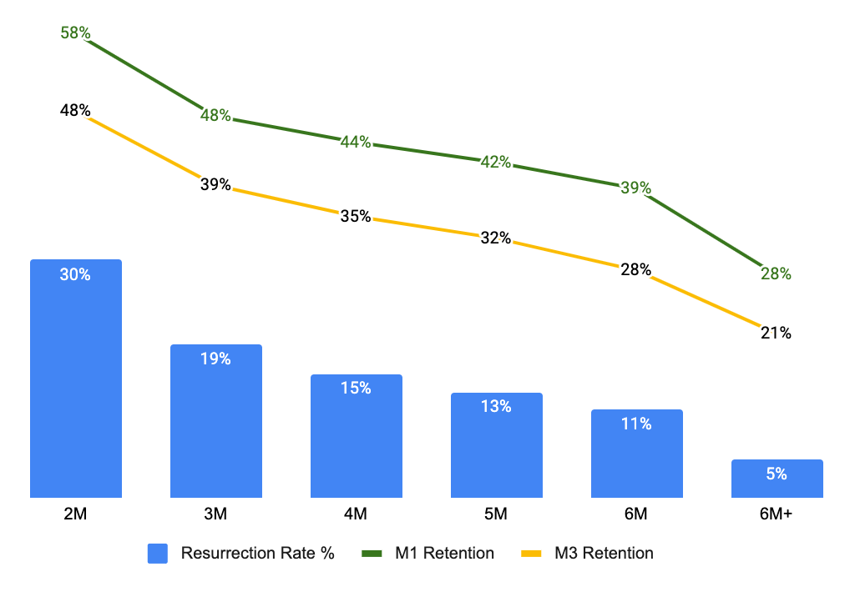
Activity: Inactivity length
Recently inactive merchants(2M) resurrect best @29%, +18pp vs. avg.
Higher the length of inactivity, lower the resurrection %
28D Resurrection % and M1, M3 Retention by months of inactivity
WHY do recently churn merchant resurrect high?
12% of merchants resurrected after 2M inactivity have comp QRs (1.2x of avg.); In Aug this number is 1.5x of avg.
Higher % of SWINGERs
>>Likely switching between QRs
Merchants who retained for at least 3 months before churning resurrect faster (44% 3M retained merch in 2M inactivity, +10pp, avg)
>> 3M retained merch left platform due to txn failure but came back faster
% Resurr Merchants
41%
17%
11%
7%
5%
19%
Intervene in early stages of inactivity; Low cost interventions for recently churned merchants & more robust (FOS revisits) for ones inactive longer
Inactive as on Mar’22 and Apr’22 resurrected + Inactive as on Apr’22 and May’22 resurrected
Excludes revisited merchants from base

Slide 21
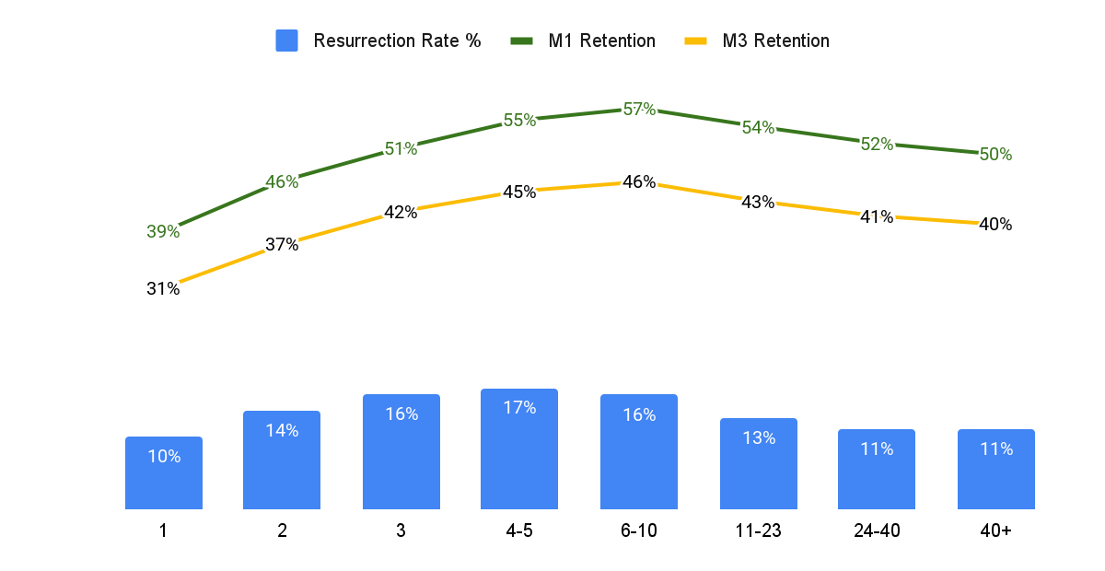
Size: Transactions
High Intensity merchants (24+) resurrect least (@7%, -4pp vs. avg.)
80% of resurrected merchants are low intensity (<6 txns); 36% only did 1 txn 28D before churning
28D Resurrection % and M1, M3 Retention by 28D txns before churning
WHY do High Intensity merchants resurrect least?
High intensity merchants experience more txn failures (4x low intensity, 1.3x medium intensity)
Competition revisits are higher on High Intensity merchants
Txn intensity
Low, 13%
Med, 15%
High, 11%
Ticket Size
#Unique payers
% Resurr Merchants
36% | 20% | 12% | 12% | 10% | 5% | 2% | 3%
Push merchants with 1 or 2 28D prior txns to 3+ by offers/comms; Use stronger interventions such as FOS revisits on high intensity inactive merchants
Inactive as on Mar’22 and Apr’22 resurrected + Inactive as on Apr’22 and May’22 resurrected
Excludes revisited merchants from base

Slide 22
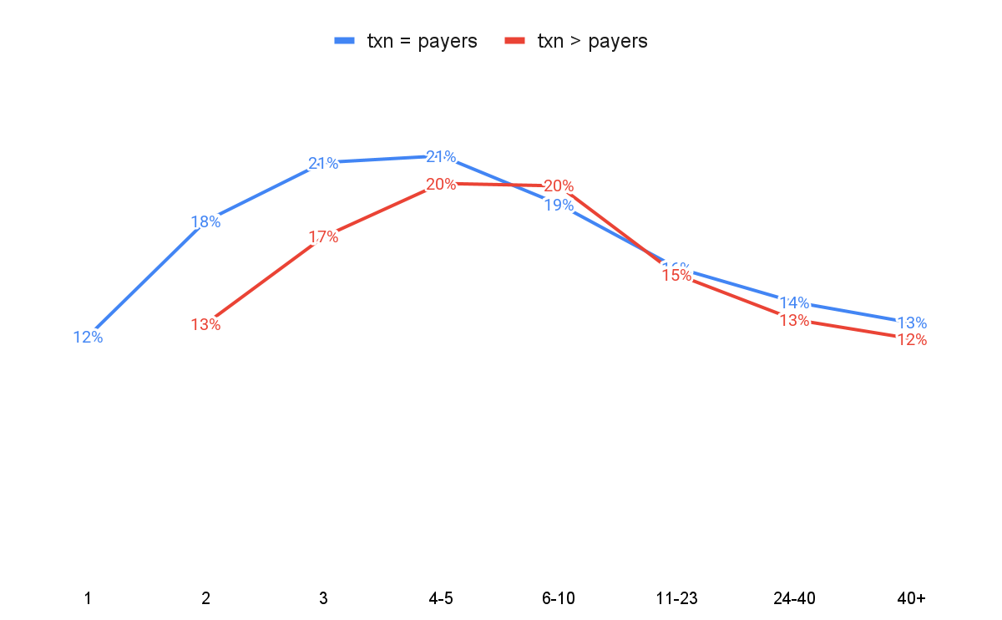
Size: Payers
#Payers is more important for lower intensity (<=6 txn) merchants
… where as #Transactions and Repeat behavior is more important at higher (>6txn) intensity
28D Resurrection % and M1, M3 Retention by #Payers vs. Repeat txn
+5pp resurrection between 2payers vs 1payer for the same intensity (2txn)
Txn intensity
Focus on increasing #of payers for low intensity merchants until at least 6 payers
Inactive as on Mar’22 and Apr’22 resurrected + Inactive as on Apr’22 and May’22 resurrected
Excludes revisited merchants from base

Slide 23
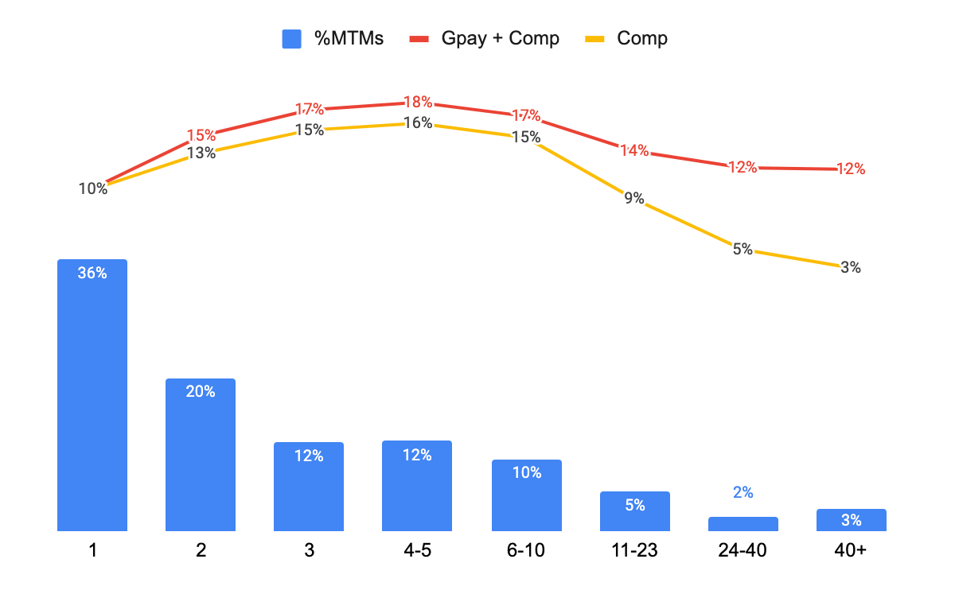
Comp: Multi-Payers
Better resurrection when receiving from multiple apps vs GPay app only
Merchants with txn = 1 are indifferent to payer app; effect becomes higher as Txn Intensity increases
28D Resurrection % and M1, M3 Retention by Payer app combinations
49% of Resurrected merchants (330k) received from only GPay app payers
74% of (Txn =1) merchants received txn (before churning) from GPay user only >> Potential consumer preference which kept them active during last month of activity
Both cohorts have equal Comp-QR merchants (~10%)
Retention: Merchants receiving from GPay+Comp retain 8pp (M3, On avg.) higher vs. Only Gpay receiving merchants
Txn intensity
Educate New merchants early to use Interoperability to improve resurrections
Inactive as on Mar’22 and Apr’22 resurrected + Inactive as on Apr’22 and May’22 resurrected
Excludes revisited merchants from base
* Multiple QR is an internal estimation based on similar FOP, bank account etc, and is considered when similarity is >=90%

Slide 24
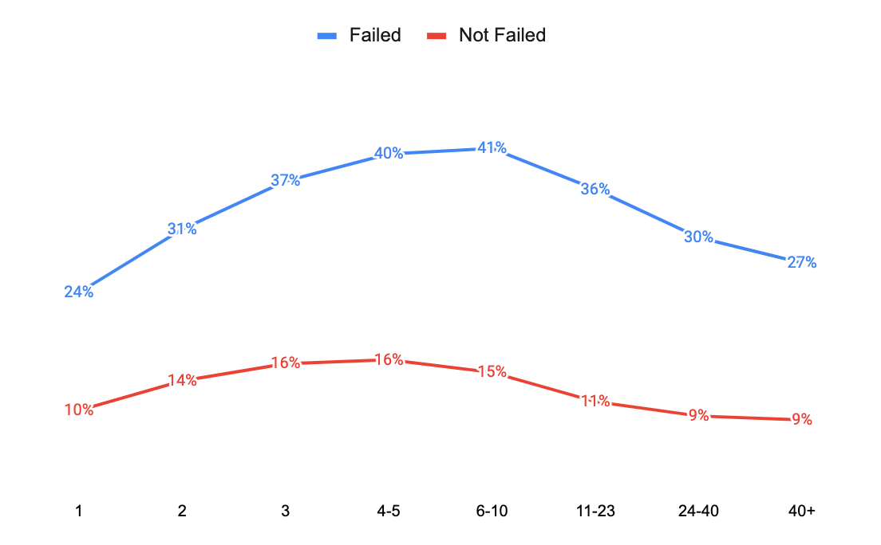
Reliability: Failure
Merchants left due to reliability issues have higher intent to resurrect
On avg. merchants facing txn failure 28D before churning resurrect 3x higher vs. avg.; Retain 1.35x higher
28D Resurrection % and M1, M3 Retention by txn failure bfr inactivity
%Txn failed is inversely proportional to resurrection rate: Merchants with txn-failure ratio ‘> 75%’ resurrect at 26%, 8pp less than failure cohort avg. but still 16pp higher than overall org. Resurrection avg.
Mid-size merchants are more resilient to txn failures; High intensity merchants do not come back easily if churned due to reliability issues
Food & Resto (0.7x vs. avg resurrection) and Groceries (0.8x) are highly sensitive categories towards reliability issues
Txn intensity
Similar results with Stuck Settlements
Send comms/revisits to high-txn intensity merchants who have faced reliability issues; Double down on categories such as Food & Resto and Groceries
Inactive as on Mar’22 and Apr’22 resurrected + Inactive as on Apr’22 and May’22 resurrected
Excludes revisited merchants from base

Slide 25
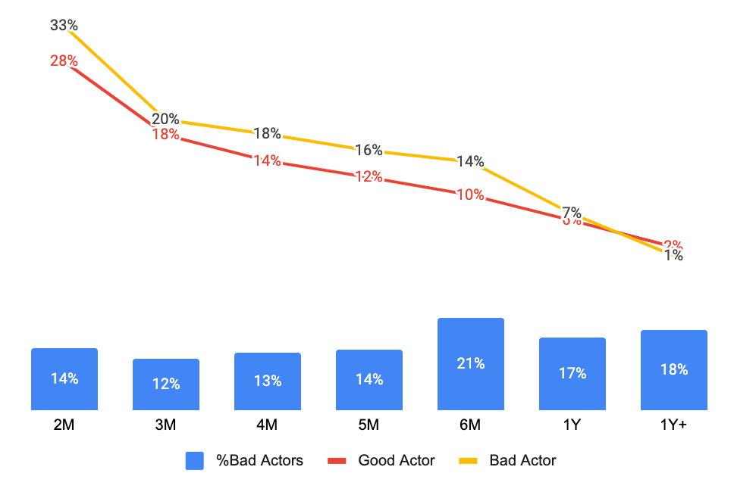
Behavior: Bad Actors
Bad actors resurrect 4pp higher on avg. & retain 10pp less
~14% resurrected merchants are bad actors which are reward seekers and thus churn faster
28D Resurrection % and M1, M3 Retention by Bad Actors
Retention decay on bad actors vs. avg. 7% on good actors
18% | 15% | 17% | 18% | 24% | 18% | 12%
Txn Intensity composition of bad actors is similar to good actors
Bad actors inactive for 1Yr + resurrect lower vs. good actors, also retain lower
West Bengal has highest (59% of resurrected merchants) bad actors
Length of inactivity
Weed out bad actors from offer constructs; low uptick in resurrection, high retention decay
Inactive as on Mar’22 and Apr’22 resurrected + Inactive as on Apr’22 and May’22 resurrected
Excludes revisited merchants from base

Slide 26
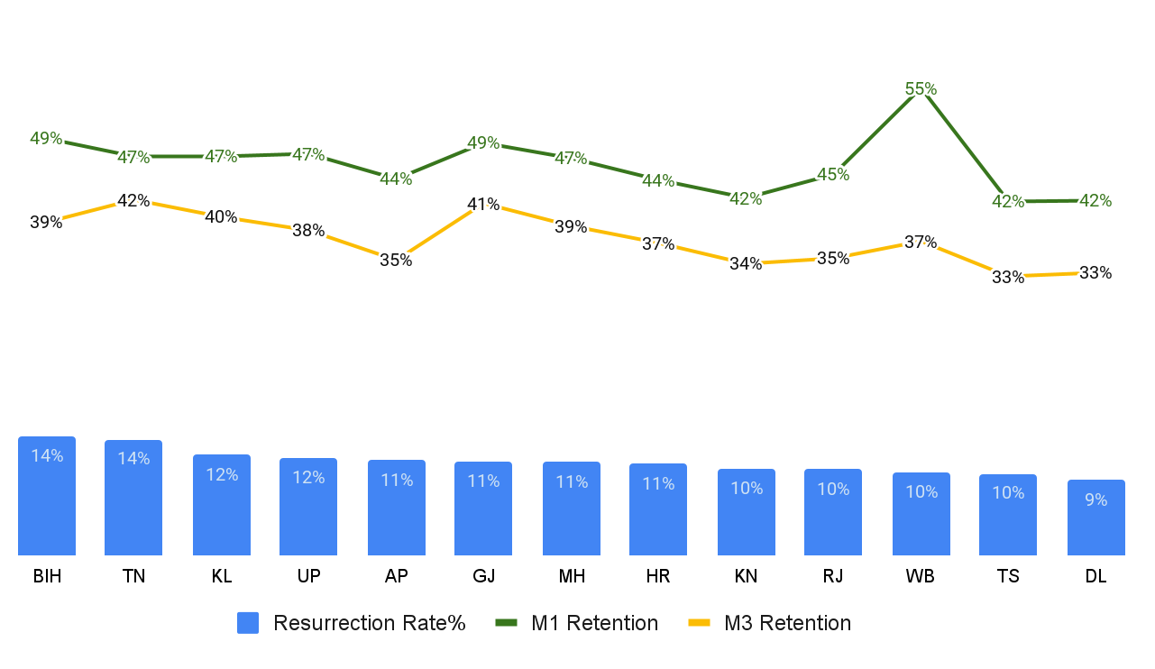
Where: Geo
Resurrection by States
BIH, TN, and KL high resurrection, TN+KL retain high in M3| Delhi, TS, WB low resurrection + M3 Retention
Merchant 28D resurrection & M1,M3 Retention Rate by Geo State
Strong States
Bihar (Highest resurrection & retention decay):
Highest recently churned merchants,
Lowest high intensity merchants >> which resurrect with difficulty
Less sensitive to failures >> resurrects at 34%, after churning due to reliability issues
Tamil Nadu & Kerela (High resurrection & lowest retention decay)
Best retention bfr churning >> lifts resurrection rate
High GMB listing >> stronger brand trust >> stronger retention
Less sensitive to failures
High consumer pull (80% merchants resurrected by GPay User)
Weak States
Telangana & Delhi (Lowest resurrection & retention decay):
Highly sensitive to reliability issues >> resurrected low if churned due to reliability issues
High Competition >> Low retention bfr churning >> lower resurrection rate
West Bengal (Lowest resurrection & HIGH retention decay)
59% of resurrected merchants are bad actors which leads to high M1 retention, but also highest decay in M1-M3 retention
Stronger interventions in weak states (DL, TN); LT Retention based offer constructs for WB
* Inactive merchants as on Mar’22 resurrected in Apr’22

Slide 27
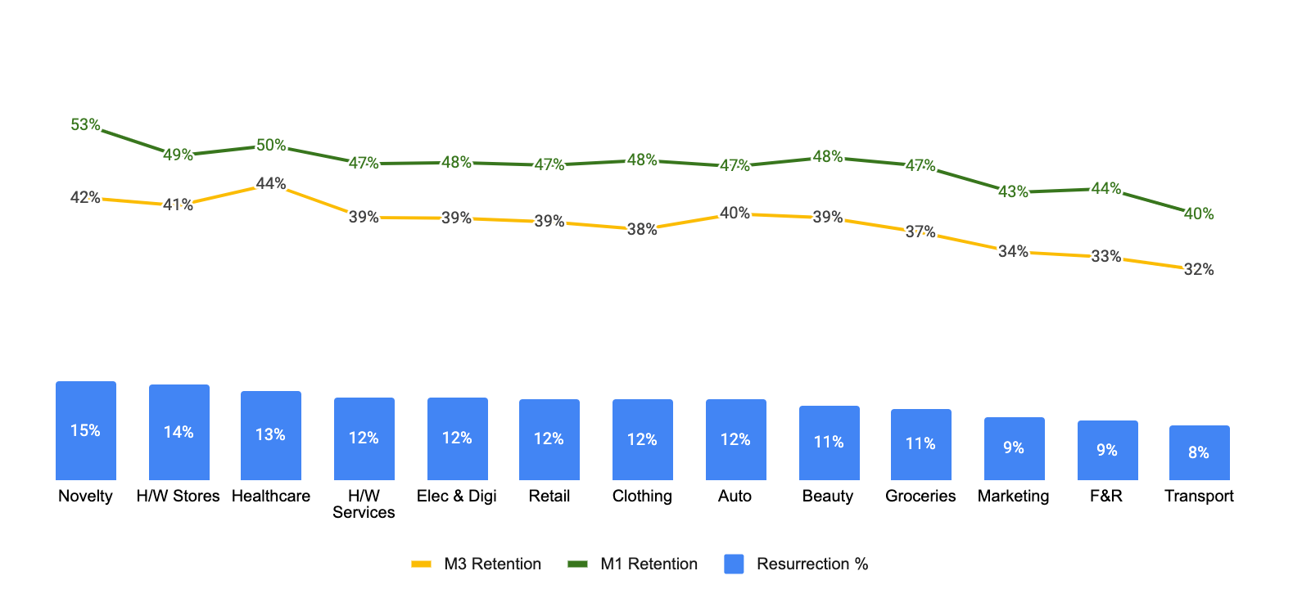
Where: Category
Resurrection by Categories
Healthcare has best retention, while Food & Restaurant lowest retention despite high intensity
Merchant 28D resurrection & M1,M3 Retention Rate by Category
Strong Categories
Novelty (Highest resurrection & retention decay):
Highest recently churned merchants,
Lowest high intensity merchants >> which resurrect with difficulty
Least sensitive to failures >> resurrects at 38%, after churning due to reliability issues
Healthcare & Hardware Stores (High resurrection & lowest retention decay)
Best retention bfr churning >> lifts resurrection rate
Least %Bad actors >> stronger retention
Less sensitive to failures
Weak Categories
F&R & Transport (Lowest resurrection & retention decay):
+ Groceries: High intensity merchants >> lower resurrection
Highly sensitive to reliability issues >> resurrected low if churned due to reliability issues
Focus on F&R, Groceries (35% of inactive merch) to improve resurrection and M3 retention
* 18Feb’22 28D MTM retained next month 18Mar’22

Slide 28
Other dimensions analysed

Slide 29
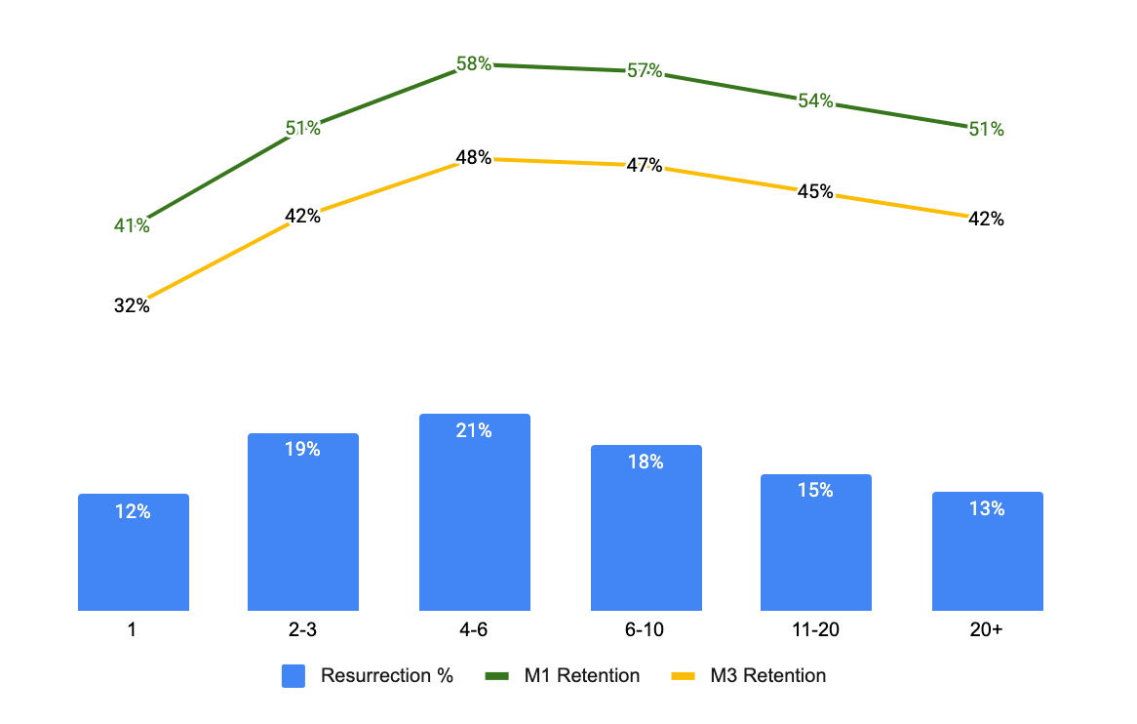
Intensity: Weeks
Highest resurrection with 6 unique payers; Retain highest @48% in 3mo
Merchants with higher #unique payers are difficult to resurrect
28D resurrection rates by #unique payers
Inactive as on Mar’22 and Apr’22 resurrected + Inactive as on Apr’22 and May’22 resurrected
Excludes revisited merchants from base

Slide 30
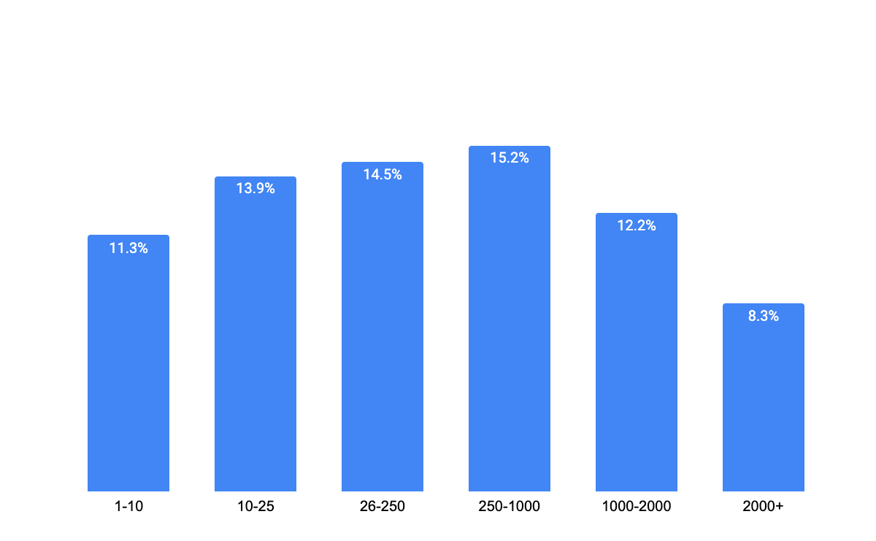
Intensity: Weeks
Difficult to bring high-ticket size merchants back if churned
Mid-ticket size merchants when churned, resurrect at highest rate
28D resurrection rates by #unique payers
Inactive as on Mar’22 and Apr’22 resurrected + Inactive as on Apr’22 and May’22 resurrected
Excludes revisited merchants from base

Slide 31
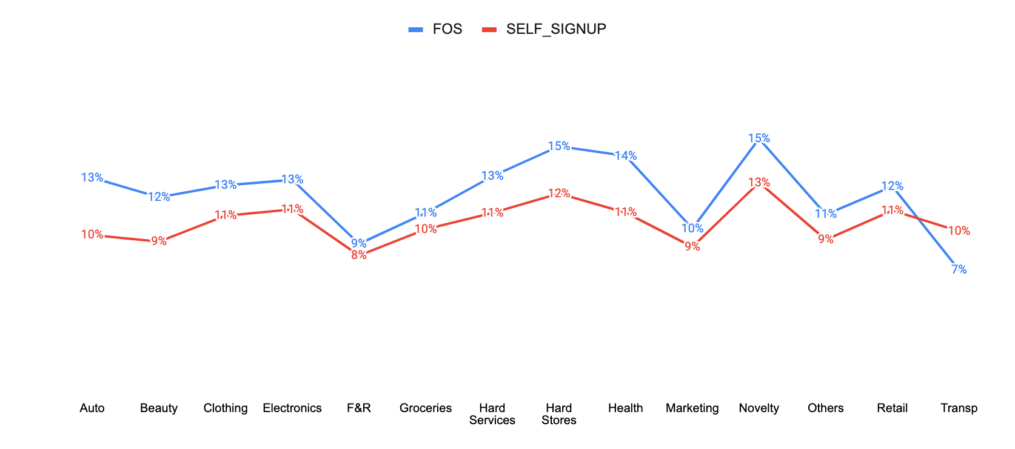
FOS acquired merchants resurrect 1pp higher; also retain 2pp higher
Gap wides for select categories such as Healthcare, Hardware stores, Automobiles etc.
28D resurrection % by #Acquisition Channel and Category
Self-onboarded merchants are harder to resurrect, specially in healthy categories; Potential loss in intent
Inactive as on Mar’22 and Apr’22 resurrected + Inactive as on Apr’22 and May’22 resurrected
Excludes revisited merchants from base

Slide 32
Merchant vintage in app does not affect resurrection rate
Merchants with similar length of inactivity & diff vintage resurrect at same rate
inactive_length | vintage_bucket | Resurrection%
3M | 3M | 17%
3M | 3-6M | 25%
3M | <1YR | 26%
3M | 1.5 YR | 26%
3M | 1.5 YR+ | 26%
3-6M | 3-6M | 9%
3-6M | <1YR | 13%
3-6M | 1.5 YR | 14%
3-6M | 1.5 YR+ | 15%
<1YR | <1YR | 5%
<1YR | 1.5 YR | 6%
<1YR | 1.5 YR+ | 7%
1.5YR | 1.5 YR | 3%
1.5YR | 1.5 YR+ | 3%
1.5YR+ | 1.5 YR+ | 1%
Inactive as on Mar’22 and Apr’22 resurrected + Inactive as on Apr’22 and May’22 resurrected
Excludes revisited merchants from base

Slide 33
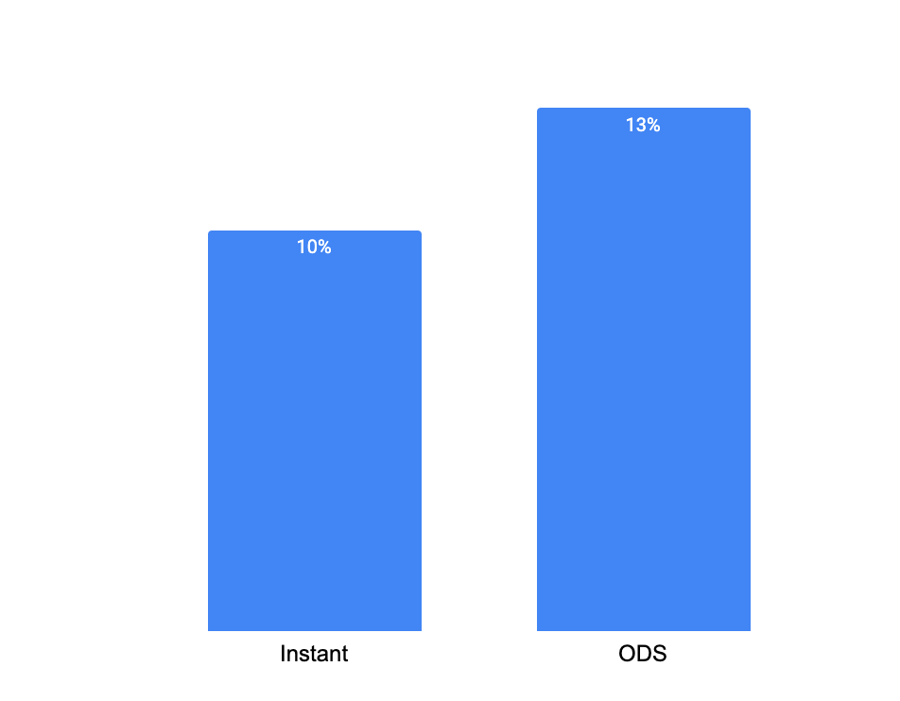
Merchants on ODS settlement resurrect 2pp higher vs. Instant
…
Promote ODS settlement adoption by merchants
Inactive as on Mar’22 and Apr’22 resurrected + Inactive as on Apr’22 and May’22 resurrected
Excludes revisited merchants from base

Slide 34
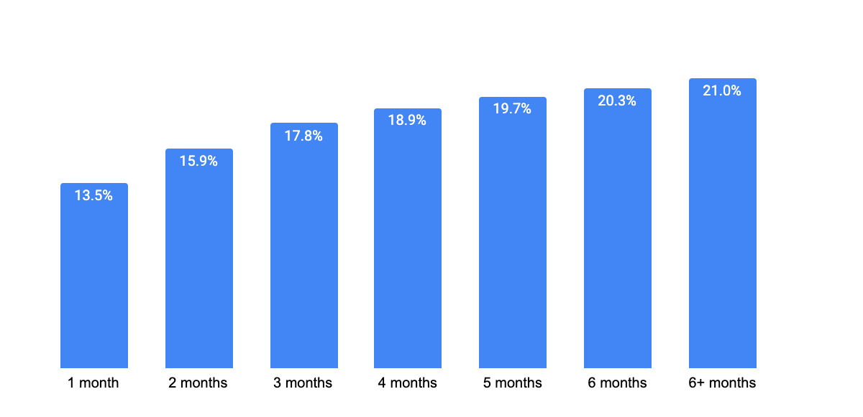
Longer the merchant retain, stronger the chances of resurrection
… plateaus at 4 months
28D resurrection % by #months retention
Achieved 40% improvement till M4 vs. M1
Ensure 4 months retention of merchants for better resilience towards churn and improved chance of resurrection
Inactive as on Mar’22 and Apr’22 resurrected + Inactive as on Apr’22 and May’22 resurrected
Excludes revisited merchants from base

Slide 35
Merchants raising support tickets before churning resurrect 0.5x lower
Retention rate of this resurrected cohort is also xx
28D Resurrection with Support calls bfr inactivity
XXX
Inactive as on Mar’22 and Apr’22 resurrected + Inactive as on Apr’22 and May’22 resurrected
Excludes revisited merchants from base

Slide 36
Appendix

Slide 37
Driver Summary
What drives Resurrection?
Category | Dimension | Insight | Recommendation
Activity | Length of Inactivity | Recently churned merchants resurrect higher (3x vs. avg.) | Low cost interventions for recently churn, More robust interventions such as FOS visits to 3M+ inactive
Size | Merchants Size (Txn Intensity, #Unique payers, Ticket Size) | Mid-size merchants (by 28D txns, ticket size) resurrect higher Difficult to bring high intensity/ticket size merchants back once churned Resurrection highest for merch with 6 #unique payers | Use offers to increase low intensity merchants to make 3+ txns Robust interventions such as FOS visits to convince High intensity merchants to resurrect
Competition activity | %GPay payer txns by total Comp QR | Merchants (with 1+ txns) resurrect better when receiving from multiple app Comp QR presence improves resurrection rate by 3x | Educate merchants to adopt Interoperability early
Reliability | %failures before churn Failed attempts during inactivity | Merchants who churned due to reliability issues have higher intent to stay digital and thus resurrect higher Failed Txn attempts made during inactivity indicates problem with QR and not lack of intent : Low hanging fruit | Strong notifs/comms to merchant facing reliability issue, F&R and Groceries are sensitive to reliability - more focus QR kit refresh for merchants who experienced failed attempts during inactivity
Behaviour | Bad Actor Is GMB | Bad actors resurrect 3pp better (if length of inactivity is less than 1 yr), but churn much faster again GMB listed merchants resurrect 3pp better >> loyalty to Google brand and other PAs | Bad actors are sensitive to offers, push low-cost offers to improve retention Educate merchants to create GMB listings & benefits
Inactive as on Mar’22 and Apr’22 resurrected + Inactive as on Apr’22 and May’22 resurrected
Excludes revisited merchants from base

Slide 38
WHY Merchants Resurrect?
6.1M inactive till Mar’22; 670k inactive merchants resurrected in Apr’22 ⇒ 11% resurrection
Hypothesis | Insight | %Contrib to Resurrection, #MTMs Estimate is NOT MECE
SWINGERs - Are there merchants with “Swinging” behaviour? | Low-Intensity merchants (Avg. 1.2 txns) demonstrate swinging behaviour - Churned and resurrected at least 4 times in last 1 Yr | 14% (95k)
Consumer Pull - Are GPay consumers asking for GPay QRs to make payments? | 67% of resurrected merchants are resurrected by a GPay Consumer vs. avg 45% | 22% (147k)
Competition Outage - Are merchants resurrecting due to comp. Reliability issues | 5 days of Comp outage contributed to 32% of resurrected merchants vs. 17% (Avg. resurrection for 5 days) | 16% (107k)
App Active/ Notifications | 18% of resurrected merchants opened their merchant app at least once in last 28 days 3pp increment in resurrection rate when clicked on a Notif | 27% (179)
Using Multiple QRs | Merchants keeping multiple QR (to hedge for reliability or just having digital presence) resurrect high | 7% (46k)
Interoperability | Merchants receiving from both Gpay & Comp apps resurrect higher vs. Only GPay | 1.5% (4k)
Reward, Ob Calls | Rewards: Positive signs of offers and rewards overall; Little data to analyse in detail Ob calls: Data unavailable to analyse | ..
Districts with use-case of lesser payments | User Density data unavailable to analyse | ..
Resurrected merchants received on consumer app while inactive | Checked, no material insights | ..
Inactive as on Mar’22 and Apr’22 resurrected + Inactive as on Apr’22 and May’22 resurrected
Excludes revisited merchants from base

Slide 39
Comp: Consumer Pull
Consumer Pull: 62% merchants resurrected by GPay User
On avg. 45% of SMB txns are via GPay Users
Consumer preference before/after churning
Gpay preferred merch exhibit consumer pull in all Geos; Comp+GPay merchants exhibit pull basis Geo’s health in GPay
~680k resurrected merchants
Rcvd by only GPay (28D txn)
(49%, 330k)
Rcvd by Comp+GPay (28D txn)
(51%, 350k)
Prior to Churning
% merchants Resurrected by Gpay Payer
Rcvd by only GPay (28D txn)
(49%, 330k)
Rcvd by Comp+GPay (28D txn)
(51%, 350k)
State | % Merch
KL | 85%
TN | 83%
TS | 79%
KN | 78%
HR | 77%
DEL | 77%
MH | 76%
GJ | 75%
UP | 73%
WB | 72%
AP | 72%
RJ | 70%
State | % Merch
KL | 75%
TN | 72%
GJ | 59%
HR | 52%
MH | 50%
WB | 49%
TS | 48%
UP | 48%
KN | 47%
DEL | 44%
BIH | 42%
AP | 40%
Strong States
% Merch
H (0.5%) | M (5%) | L (94.5%)
H (10%) | M (25%) | L (65%)
~95% low intensity merchants sustained early churn likely due to GPay payer (Consumer preference)
Mixed Bag
% merchants Resurrected by Gpay Payer
Weak States
78% | 80% | 75%
58% | 52% | 46%
Sustained preference, likely stronger Geos
Run GPay SMB auto-vouchers in weaker states such as Rajasthan, Bihar and AP
Inactive as on Jul’22 and Aug’22 resurrected
Excludes revisited merchants from base

Slide 40
Resurrection of inactive merchants; Segments 2&3
Update numbers
GPay Merchant Health Spectrum
x%
Probability of becoming MTM in the next 28D
Total Active Merchants: 10M
38%
Ever Transacted: 8.2M
48%
Inactive previous 28D: 4.5M
MTM previous 28D: 3.8M f h
13%
80%
1.7M g
Never txd
3.7M
Inactive for >56D
0.8M fh
<=56D inactive
1.8M g
1-6 txn
2M g
>6 txn
3%
9%
31%
61%
96%
1. Never
2. Inactive
3. Churning
4. LowInt
5. HighInt
17%
37%
8%
18%
21%
Activation
Resurrection
Retention
In wakanada, 1&5 were active 21D and active all 5 weeks

Slide 41
WHY Summary
WHY Merchants Resurrect?
Hypothesis | Insight | Recommendation
SWINGERs | 14% resurrected merchants exhibit SWINGING: Churned and resurrected at least 4 times in last 1 Yr | Weed out merchants with “Swinging” behaviour from offers/comms; Little value due to poor Retention
Consumer Pull | 62% of merchants resurrected by a GPay Consumer vs. avg 45% | Run SMB auto-vouchers in weaker states such as RJ, Bihar and AP
Competition Outage | 5 days of Comp outage contributed to 32% of resurrections vs. 16% (Avg. for 5 days) | Double down on Notifs/Comms during Comp outage; Provide Long-Term Retention “Welcome Offer” for improved Retention
App Active/ Notifications | 18% of resurr merchants opened merchant app at least once (28D) | Push relevant notifs/comms to merchants motivating them to open merchant app more
Bad Actors | 14% of resurrections; Resurrect 4pp higher, retain 10pp less | “Sensitive to offers” cohort, Experiment with offer construct to improve retention
Using Multiple QRs | Merchants keeping multiple QR (to hedge for reliability or just having digital presence) resurrect high | Revisit high intensity single QR merchants to resurrect them back
Interoperability | Merchants receiving from both Gpay & Comp apps resurrect higher | Educate New merchants early to use Interoperability
Reward, Ob Calls | Rewards: Positive signs of rewards overall; Little data to analyse in detail Ob calls: Data unavailable to analyse
Districts with use-case of lesser payments | User Density data unavailable to analyse
Resurrected merchants received on consumer app while inactive | Checked, no material insights
Inactive as on Mar’22 and Apr’22 resurrected + Inactive as on Apr’22 and May’22 resurrected
Excludes revisited merchants from base

